Slide 1

信用评分卡汇报
丁祖平；魏子玢；陈乃恋；宋婉晴；徐诗雨；曹悦好；徐易；曾亚南

Slide 2
数据获取
数据来自于Kaggle的Give Me Some Credit，有15万条的样本数据
Variable Name | Description | Type
SeriousDlqin2yrs | Person experienced 90 days past due delinquency or worse | Y/N
RevolvingUtilizationOfUnsecuredLines | Total balance on credit cards and personal lines of credit except real estate and no installment debt like car loans divided by the sum of credit limits | percentage
age | Age of borrower in years | integer
NumberOfTime30-59DaysPastDueNotWorse | Number of times borrower has been 30-59 days past due but no worse in the last 2 years. | integer
DebtRatio | Monthly debt payments, alimony,living costs divided by monthy gross income | percentage
MonthlyIncome | Monthly income | real
NumberOfOpenCreditLinesAndLoans | Number of Open loans (installment like car loan or mortgage) and Lines of credit (e.g. credit cards) | integer
NumberOfTimes90DaysLate | Number of times borrower has been 90 days or more past due. | integer
NumberRealEstateLoansOrLines | Number of mortgage and real estate loans including home equity lines of credit | integer
NumberOfTime60-89DaysPastDueNotWorse | Number of times borrower has been 60-89 days past due but no worse in the last 2 years. | integer
NumberOfDependents | Number of dependents in family excluding themselves (spouse, children etc.) | integer

Slide 3
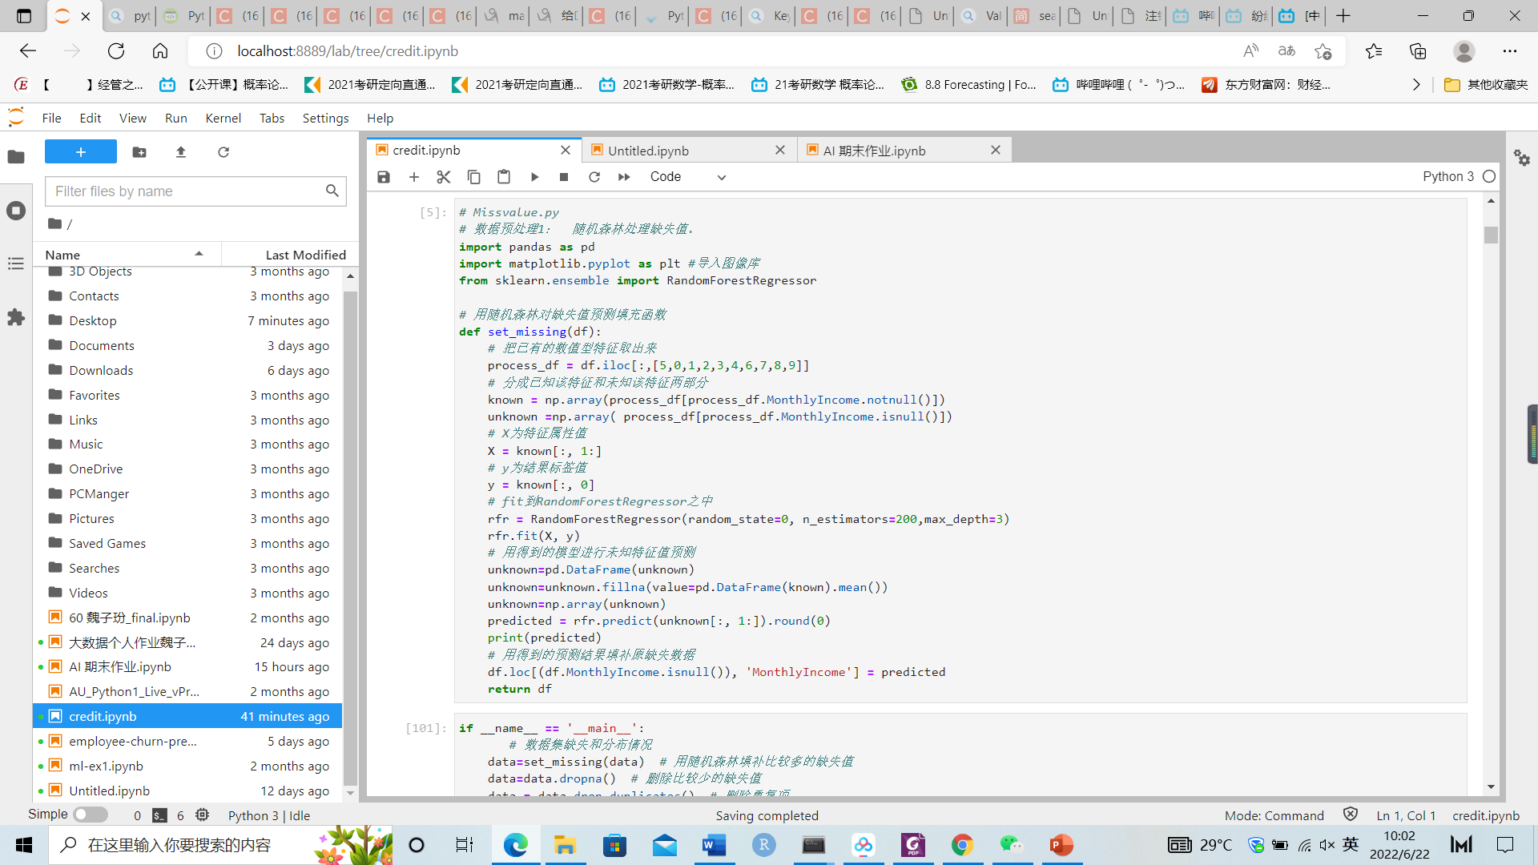
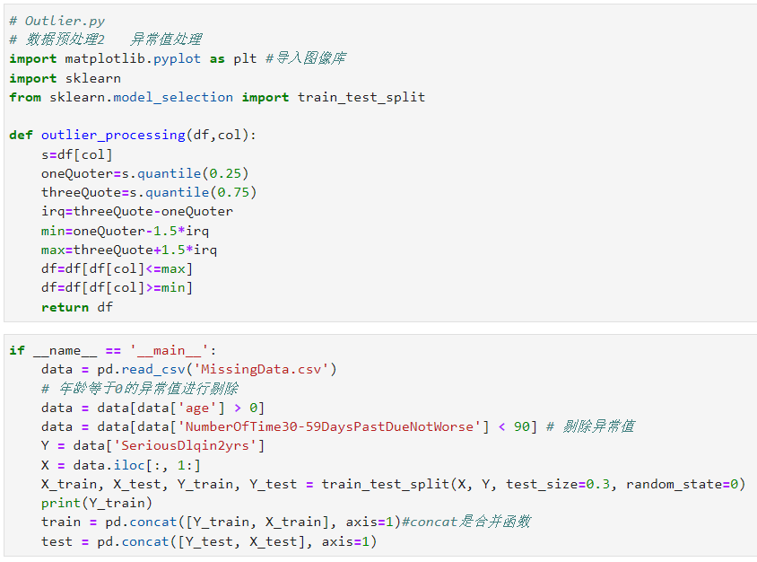
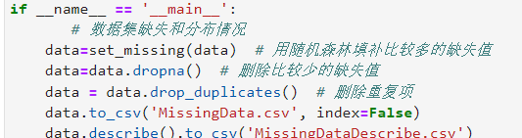
数据预处理
针对缺失值用random forest和直接剔除法进行处理，对于异常值主要根据实际情况和箱型图的数据分布对异常值进行删除。
把数据分为训练集和测试集，为接下来的模型训练做好准备

Slide 4
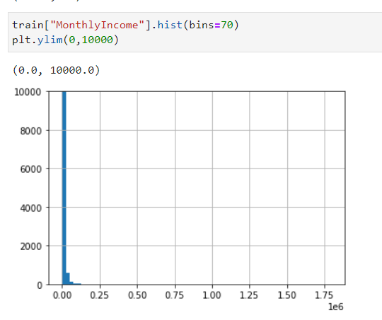
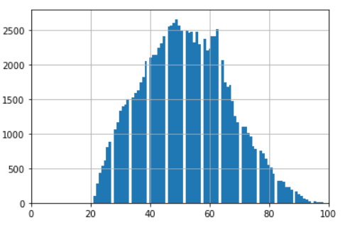
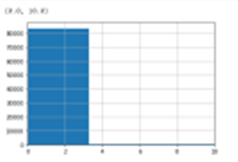
探索性分析
月收入直方图
Age 直方图
Debt ratio 直方图
可以看出，月收入集中在0-125000这个区间；年龄的分布接近于正态分布；debt ratio集中于0-3之间

Slide 5
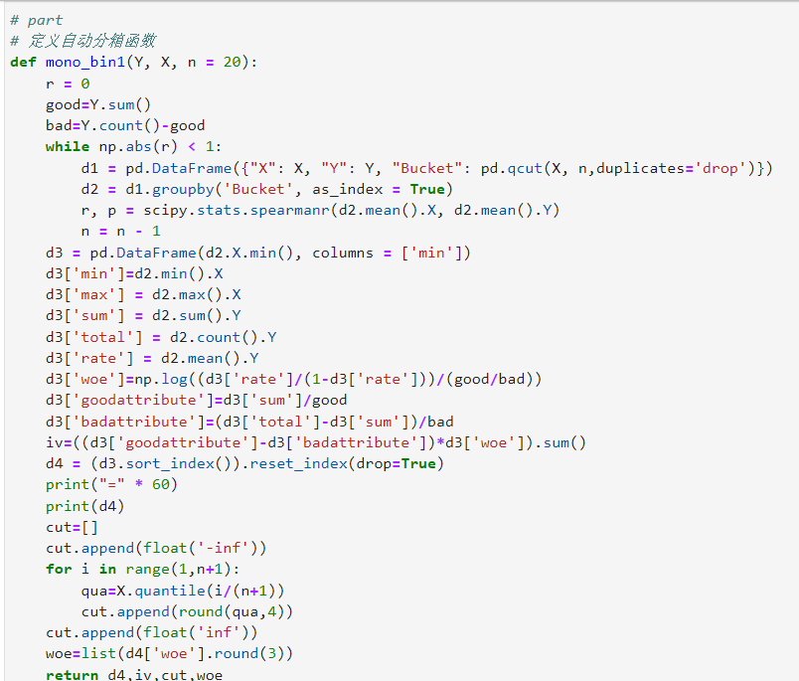
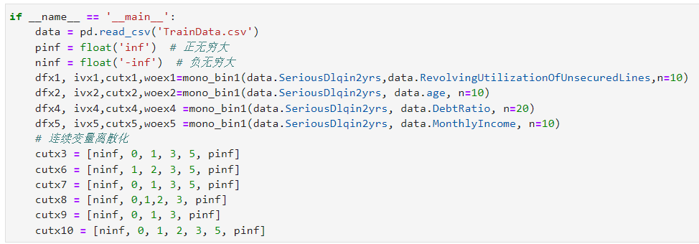
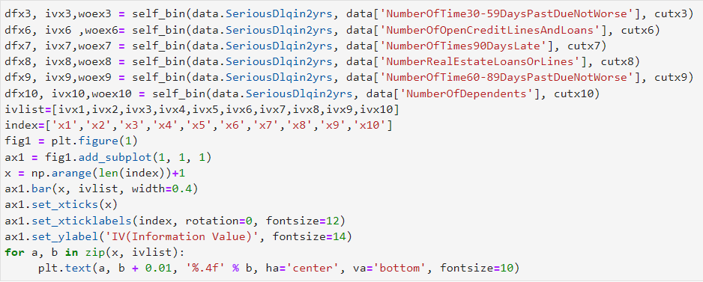
变量选择
分箱处理

Slide 6
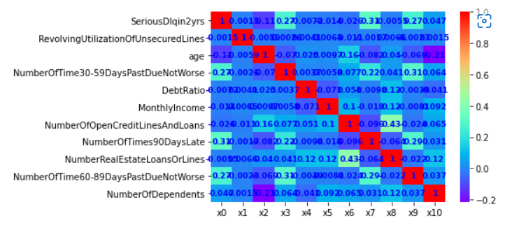
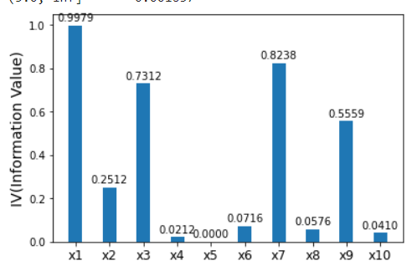
变量选择
相关性分析和IV筛选
可以看出，DebtRatio、MonthlyIncome、NumberOfOpenCreditLinesAndLoans、NumberRealEstateLoansOrLines和NumberOfDependents变量的IV值明显较低，所以予以删除。

Slide 7
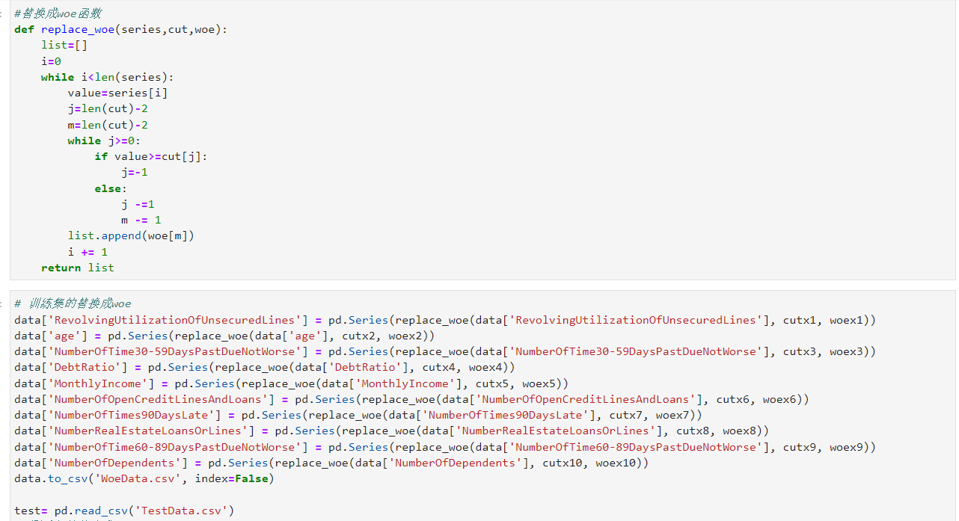
构建模型
WoE转换

Slide 8
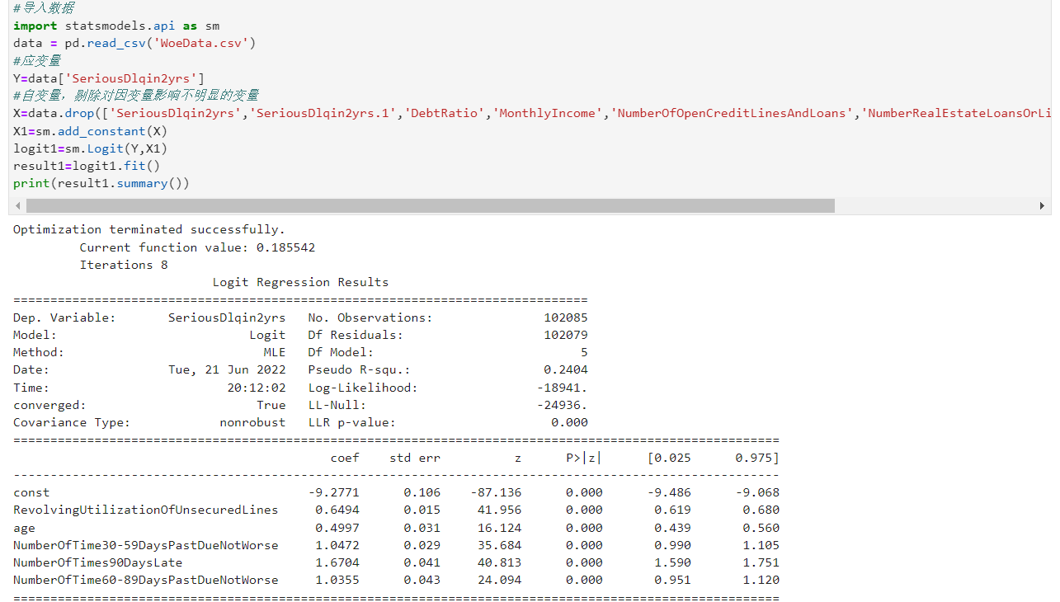
构建模型
机器学习

Slide 9
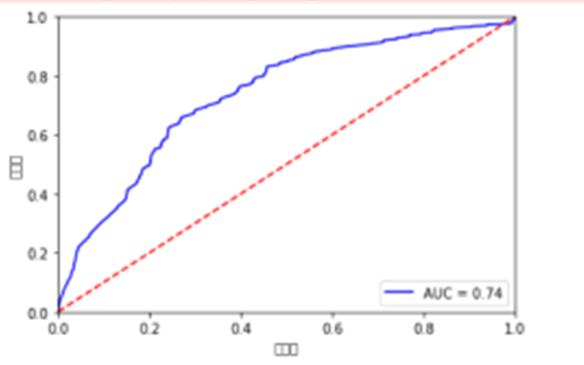
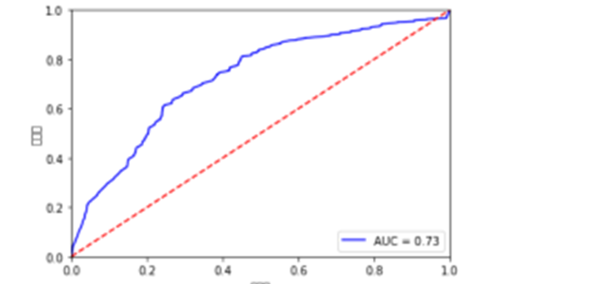
模型评估
ROC曲线和AUC
训练集
测试集
AUC较高，模型比较好

Slide 10
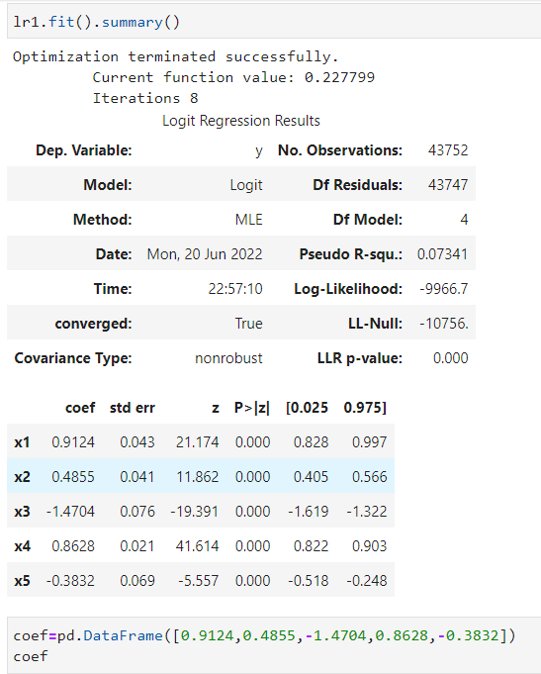
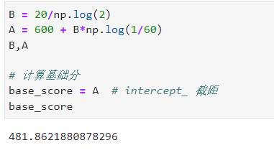
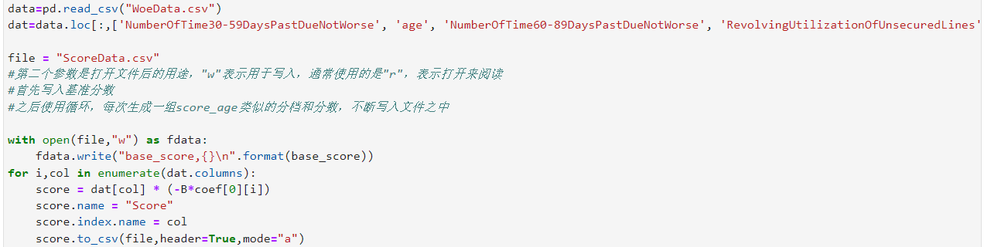
评分卡转换

Slide 11
谢谢观看！

